Slide 1


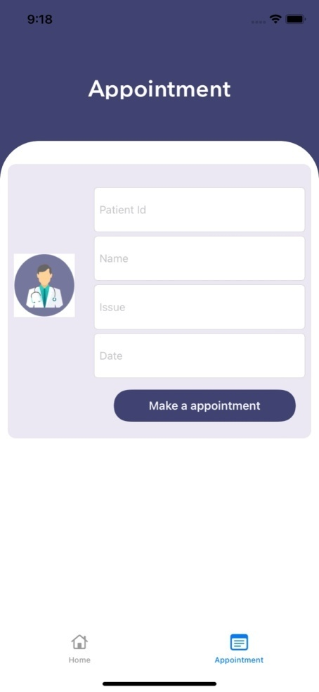
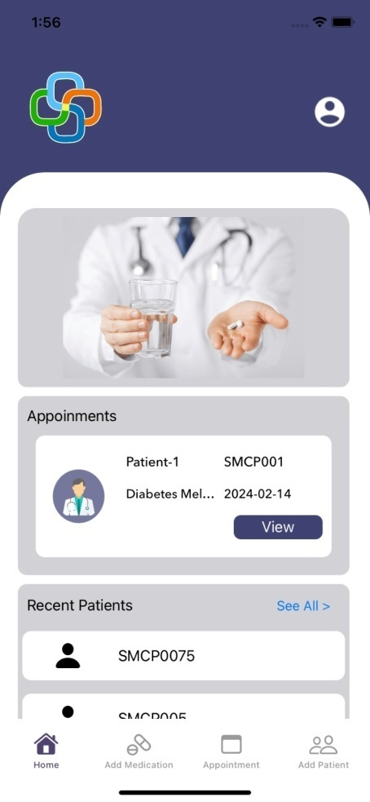
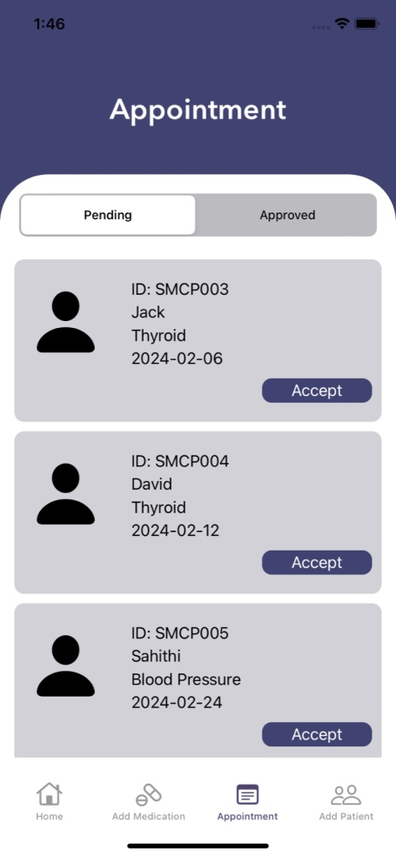
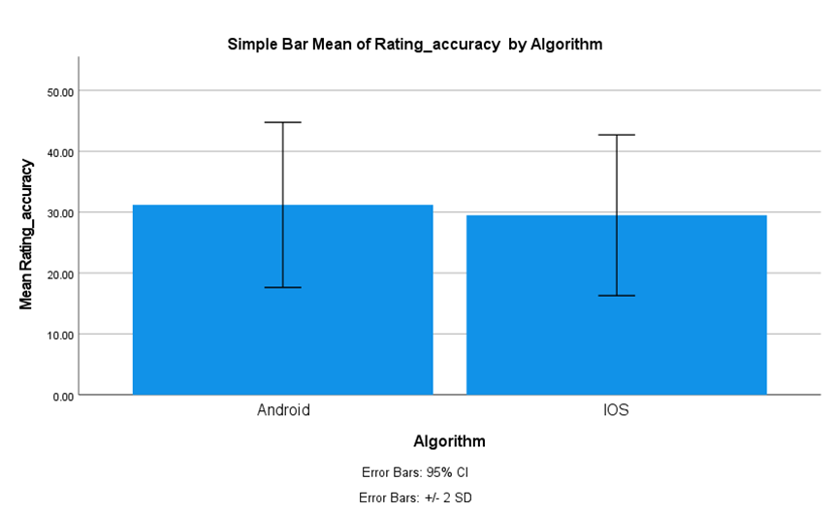
Name: Ms Nisha N Register Number: 192011495L
Guided by Dr T Suresh Balakrishnan
Ms. Poorani.S
Guided by Dr. Mary Valantina. G
Enhancing Rating Accuracy Through Quantitative Survey on Medication Reminder App for A Comparative Study Between Android Application and iOS Application
This Application displays the patient Appointment of the Medication-Reminder application from the doctor login where the doctor can view his daily appointments for clarifications.
Highlight the significant role that ratings serve in providing objective feedback on the overall application experience, satisfaction, and usability.
Clearly outlining the objective of the study, which is to enhance the Medication-Reminder's user-centered quality by identifying areas for user experience improvement and measuring user satisfaction using quantitative ratings.
The study's findings might improve the Medication-Reminder user experience, which would widen the educational and career-growth options available to medical professionals.
A user-friendly interface, clear appointment notifications, and intuitive features can empower patients to actively engage with their healthcare management, leading to better treatment outcomes and overall health.
INTRODUCTION
Medtime
Response Time
Data Utilizattion
Development Time
Rating Accuracy
Fig 1:Medication-Reminder
MATERIALS AND METHODS
Retrieve User Data from the Database
Android Application
Android Application Process
Database – XAMPP(MySQL)
PHP- Visual Studio code.
Testing- Postman
Output- Android Studio
Creating URL for backend connection with database
Choose Application
Strategy
Analysis & Planning.
UI/UX Design.
App Development.
Testing.
Deployment & Support.
Develop and Test the Data
Calculating Rating Accuracy
Data Collection Processing and measuring the data of sample size of N = 10, N = 10 Total = 20
iOS Application Process
Database – XAMPP(MySQL)
PHP- Visual Studio code.
Testing- Postman
Output- Swift Xcode
User inputs (GET/POST) for Structure Model &
backend connection
IOS Application
Retrieve User Data from the Database
RESULTS
Group Statistics
 | Algorithm | N | Mean | Std. Deviation | Std. Error Mean
Rating Accuracy | Android | 10 | 87.67 | 3.310 | .956
 | iOS | 10 | 93.00 | 1.954 | .564
Comparision of Andriod and iOS Application in terms of Rating Accuracy.
The Mean Recovery Rate of iOS is significantly higher than Android in Medication-Reminder.
This indicates a higher level of precision and reliability in the ratings provided by the iOS application.
which could be attributed to differences in the underlying algorithms
or interface design between the two platforms.
Fig 2: Comparision of Andriod and iOS Application in terms of Rating Accuracy.
Fig 3:Appointment Booking
Fig 4:Doctor Home Screen
Fig 5:Appointment
DISCUSSION AND CONCLUSION
Based on T-test Statistical analysis, the significance value of p=0.01 (independent sample T - test p<0.05) is obtained and shows that there is a statistical significant difference between the group 1 and group 2.
Overall, the Response time of the Medication-Reminder iOS Application is 89.71ms and it is better than the Android Application.
Medication-Reminder Android Application is 79.67ms
The research results clearly show that when it comes to grading accuracy efficiency inside the Medication-Reminder the iOS application performs better than the Android application.
This suggests that only does the iOS application exhibit superior response time and grading accuracy efficiency, nut it also tends to provide a more satisfactory user experience overall. This aspect could be crucial in determining the overall success and adoption rate of the application among users.
BIBLIOGRAPHY
Anderson, Kevin, Oksana Burford, and Lynne Emmerton. 2016. “App Chronic Disease Checklist: Protocol to Evaluate Mobile Apps for Chronic Disease Self-Management.” JMIR Research Protocols 5 (4): e6194.
Grayek, Emily, Tamar Krishnamurti, Lydia Hu, Olivia Babich, Katherine Warren, and Baruch Fischhoff. 2023. “Collection and Analysis of Adherence Information for Software as a Medical Device Clinical Trials: Systematic Review.” JMIR mHealth and uHealth 11 (1): e46237.
Salgado, Teresa M., Alexa Fedrigon, Donna Riccio Omichinski, Michelle A. Meade, and Karen B. Farris. 2018. “Identifying Medication Management Smartphone App Features Suitable for Young Adults With Developmental Disabilities: Delphi Consensus Study.” JMIR mHealth and uHealth 6 (5): e9527.
Tabi, Katarina, Abnashi Singh Randhawa, Fiona Choi, Zamina Mithani, Friederike Albers, Maren Schnieder, Mohammadali Nikoo, et al. 2019. “Mobile Apps for Medication Management: Review and Analysis.” JMIR mHealth and uHealth 7 (9): e13608.

